Slide 1

Hello,
I’m
LAXMI RAWAT
Education:- Pursuing B.Com (Honours)
College:- Shriram Institute of Management and Technology
Skills:- Microsoft Excel, Power Query & Power BI

Slide 2
ABOUT
ME
My name is Laxmi Rawat. I completed my schooling from USR Indu Public School. Currently, I am pursuing B.Com (Honours) from Shriram Institute of Management and Technology.
To enhance my technical skill set, I have completed a Basic Computer Course and Tally from GIIT and a Data Analytics course from Pixal Skillz.
Beyond academics, my passion is Art and Craft, which reflects my strong attention to detail and creative perspective.

Slide 3
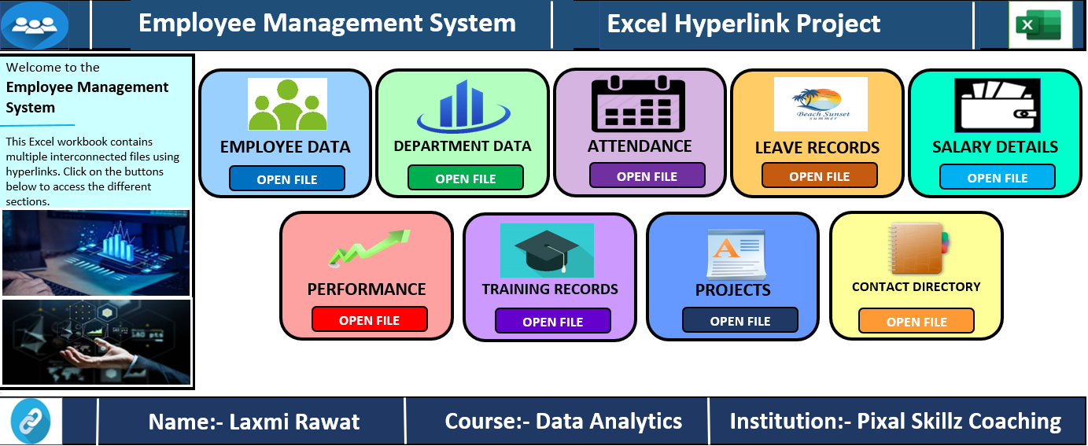
Hyperlink Project
Project 1 : Employees Data
Created an employee management system using excel hyperlink.
Linked different excel sheets for easy navigation.
Made data access simple, fast, and user-friendly.
PROJECT LINK : VIEW PROJECT

Slide 4
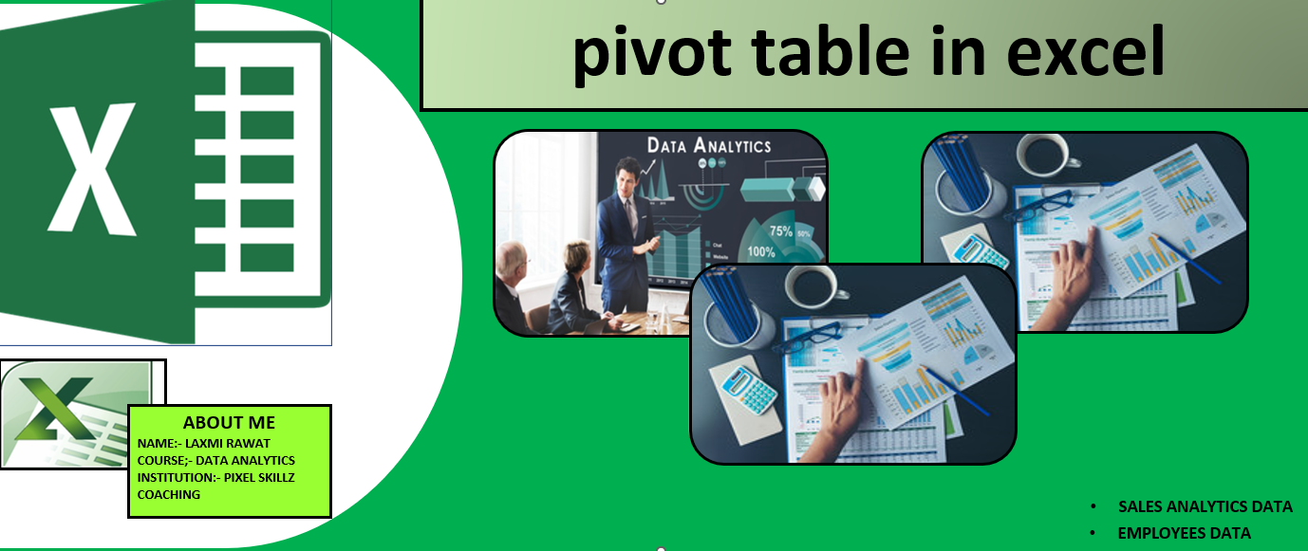
Pivot Table Project
Project 1 : Sales Data Analysis
Analyzed 3 year of shop sales data.
Summarized sales by category and product.
Created pivot tables for easy data analysis.
Project 2 : Employee Data Analysis
Organized employee records.
Summarized department wise employee data.
Compared employee information using pivot tables
PROJECT LINK : VIEW PROJECT

Slide 5
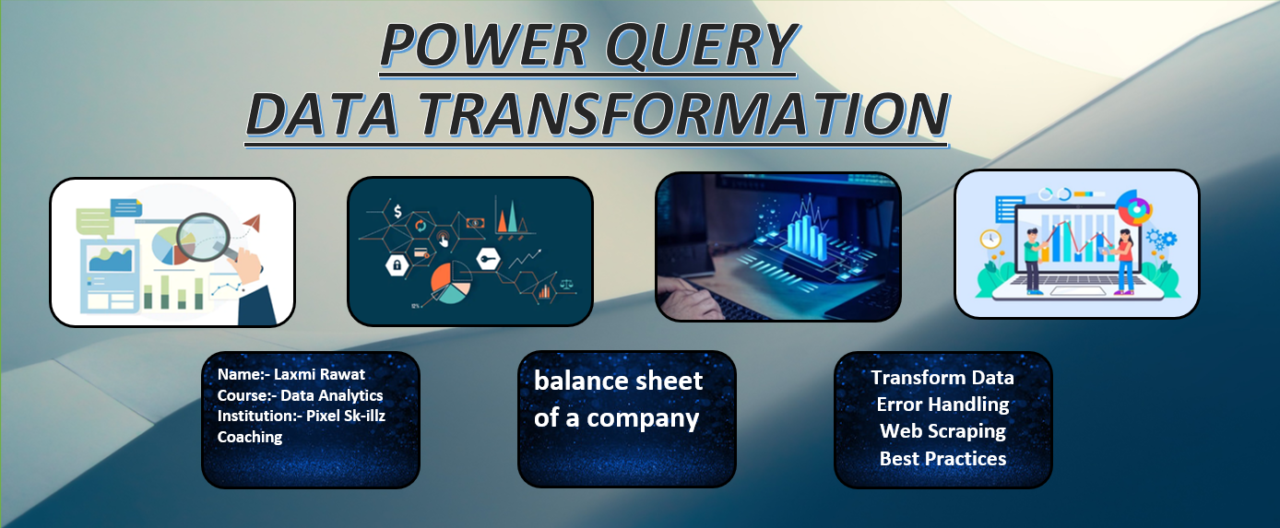
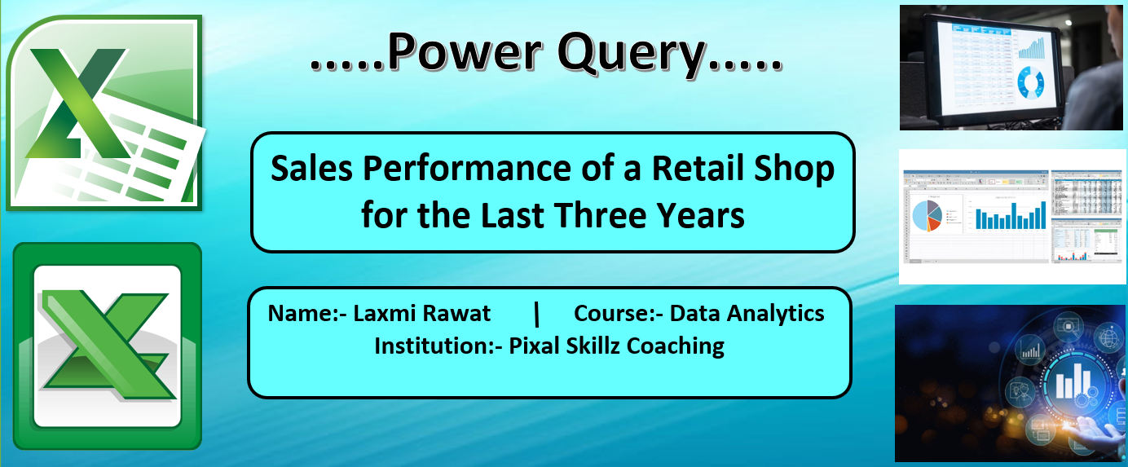
Power Query Project - 1
Power Query Project - 2
Project 1 : Textile Company Previous 3 Years Balance Sheet Data
Learned to automate repetitive data tasks.
Explored data cleaning and transformation.
Project 2 : Sales Performance of a Retail Shop for the last Three Years
Analyzed 3 years of shop sales data.
Evaluated sales performance and trends.
Identified top performing products.
PROJECT LINK : VIEW PROJECT
PROJECT LINK : VIEW PROJECT

Slide 6
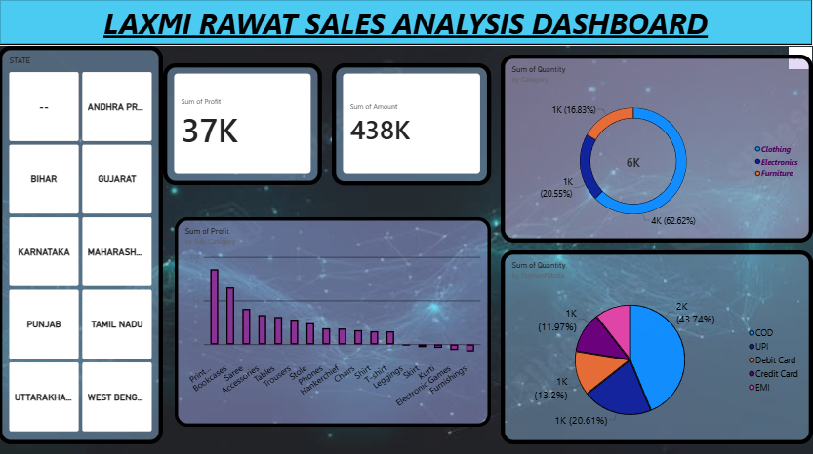
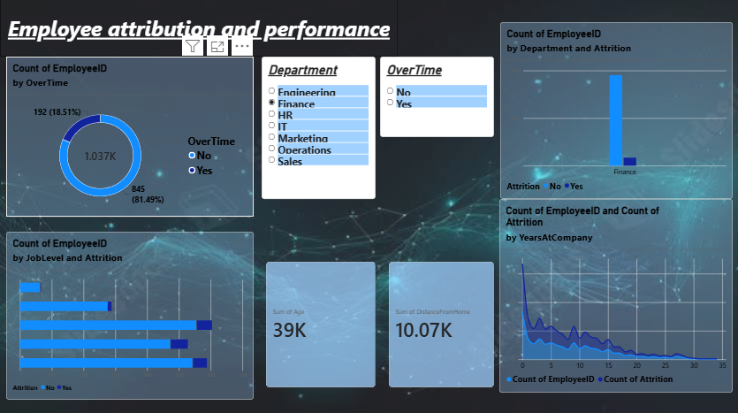
Power BI Project - 1
Power BI Project - 2
Project 1 : E- commerce sales
Analyzed e-commerce sales and business performance.
Visualized sales, profit and product trends using charts.
Project 2 : Employees Attribution Analysis
Analyzed employee attribution and workforce trends.
Created charts and cards to identify employee turnover.
PROJECT LINK : VIEW PROJECT
PROJECT LINK : VIEW PROJECT

